Slide 1


生醫訊號處理概論
期末報告
報告者：1158046 張詠翔
指導老師：紀虹名 Ph.D.

Slide 2

Preliminary Introduction
Name：
Implantable brain machine interfaces: first-in-human studies, technology challenges and trends
Journal：
Rapeaux, Adrien B., and Timothy G. Constandinou. “Implantable brain machine interfaces: first-in-human studies, technology challenges and trends.” Current opinion in biotechnology 72 (2021): 102-111.(Times Cited：59)

Slide 3
Outline
1
4
Introduction
Result
2
5
Discussion
Objective
3
6
Material and Method
Conclusion

Slide 4
Part 1
Introduction

Slide 5
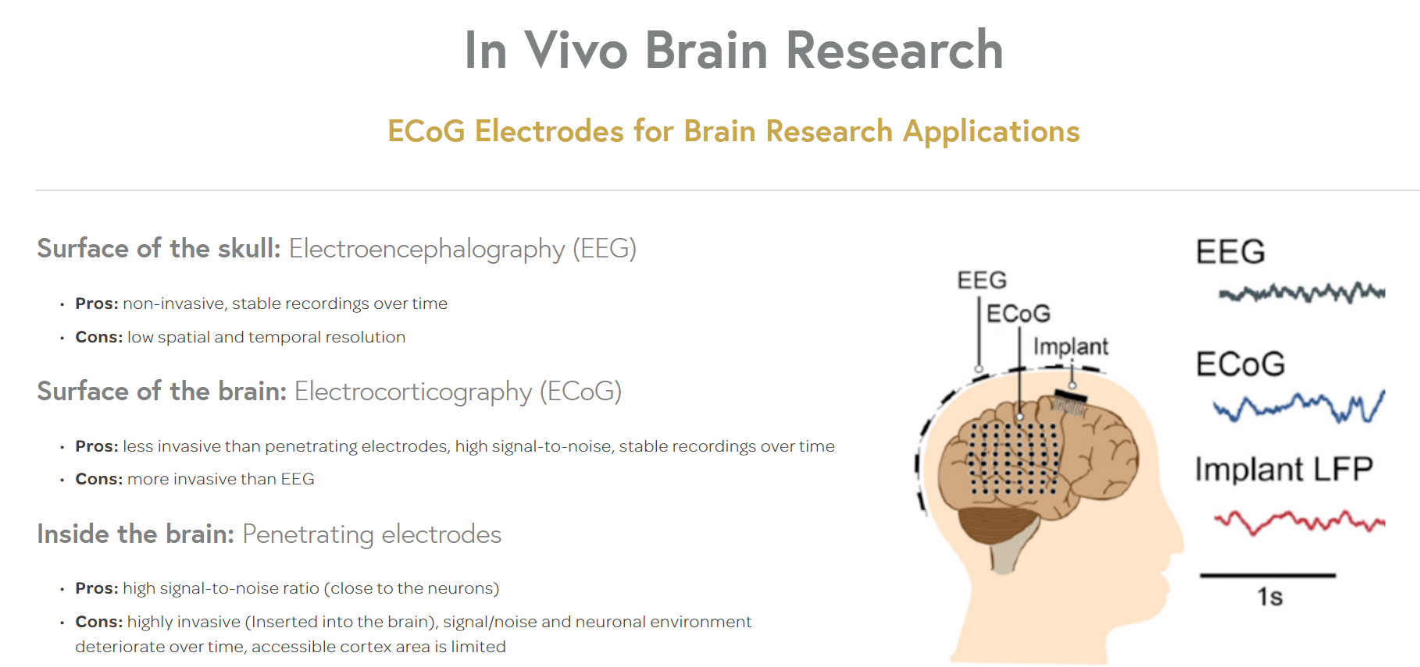
Introduction(1/3)
-BCI&BMI-
From all these approaches it is widely accepted that：
implantable methods (e.g. ECoG) outperform non-invasive methods (e.g. EEG, fNIRS) (due to a significantly higher spatial and temporal resolution and signal-to-noise ratio)
There exists a plethora of methods to observe neural activity
Fig. 1. methods EEG v.s. ECoG by digital
1

Slide 6
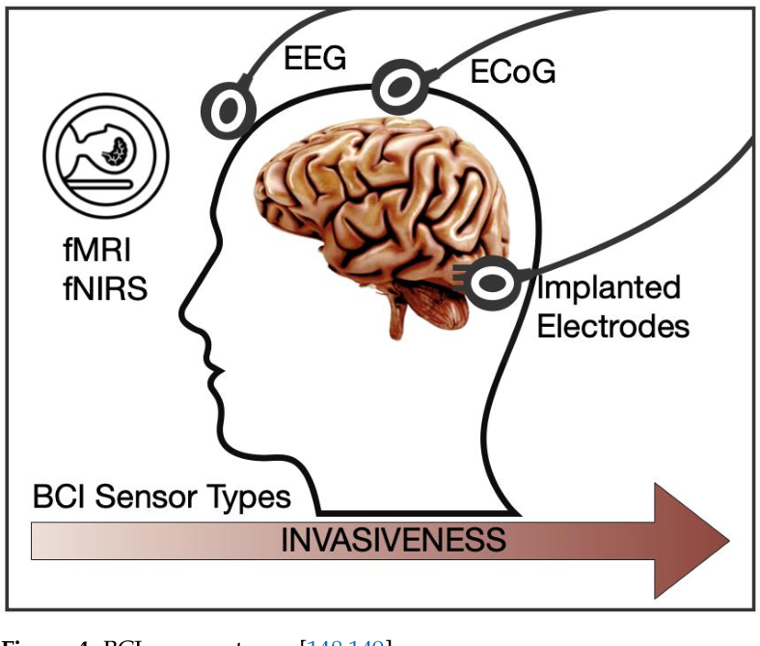
Introduction(2/3)
-BCI&BMI-
Brain computer interfaces (BCIs) and brain machine interfaces (BMIs) refer to neurotechnologies that observe activity within the brain and decode or decipher this to extract useful information
Although the terminology BCI and BMI are often used interchangeably, there is a tendency within the community to refer to：
non-invasive interfaces using BCI and implantable interfaces using BMI
Fig. 2. observation methods invasiveness rate compare
2

Slide 7
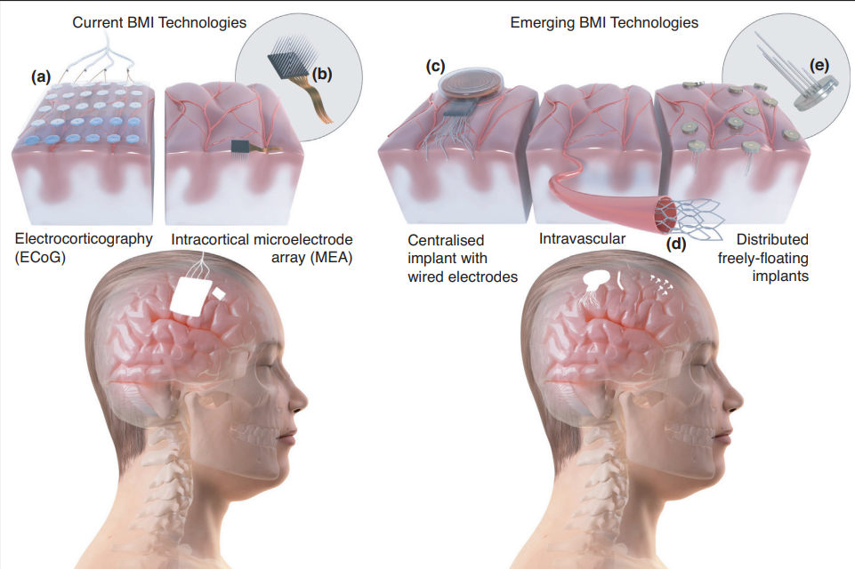
Introduction(3/3)
-BCI&BMI-
Fig. 3. Neural interface types
3

Slide 8
Part 2
Objective

Slide 9
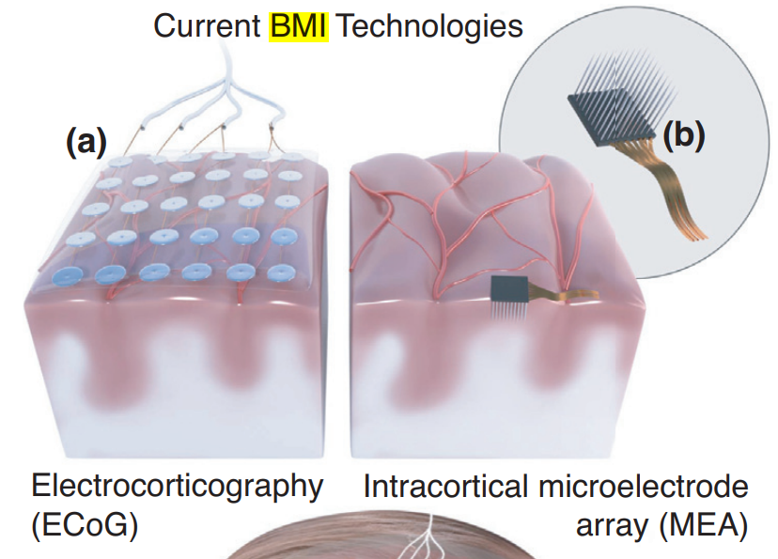
Objective(1/3)
-Implantable human BMIs today-
Implantable human BMIs have to date utilised two main categories of neural interfaces targeting the motor cortex:
ECoG grids (placed on the surface of the brain)
penetrating microelectrode arrays (MEAs) (inserted into cortical tissue)
The first implantable BMI demonstrated in human was in 2004. This used an intracortical MEA
A second implantable technology that has been used in human BMIs is ECoG
4

Slide 10

Objective(2/3)
-MEA-
5

Slide 11
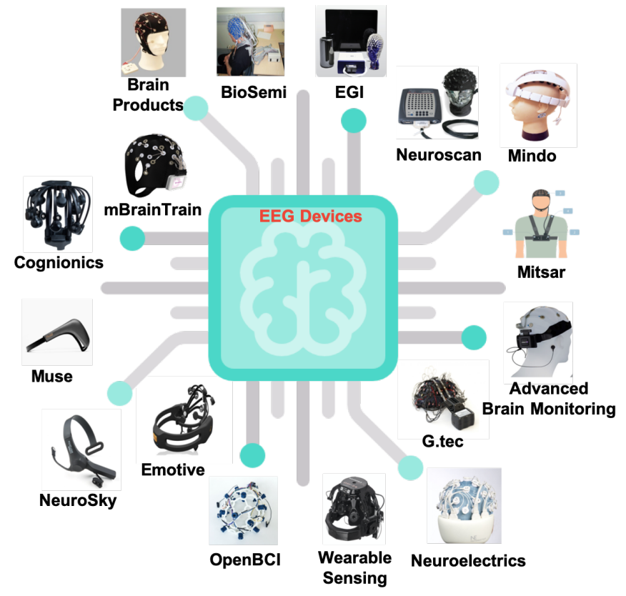
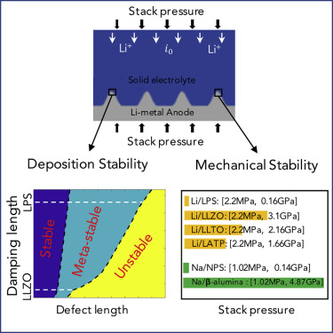
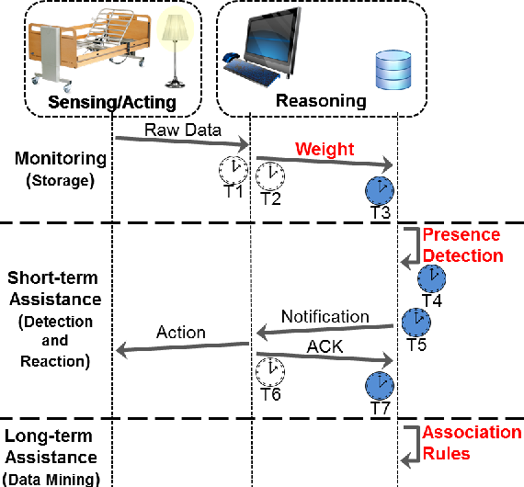
Objective(3/3)
- Technical challenges-
The challenges can be separated roughly into three categories, namely scalability and portability, electrode stability and yield, and information transfer rate
Fig. 4. scalability and portability
Fig. 5. electrode stability and yield
Fig. 6. information transfer rate
6

Slide 12
Part 3
Material and Method

Slide 13
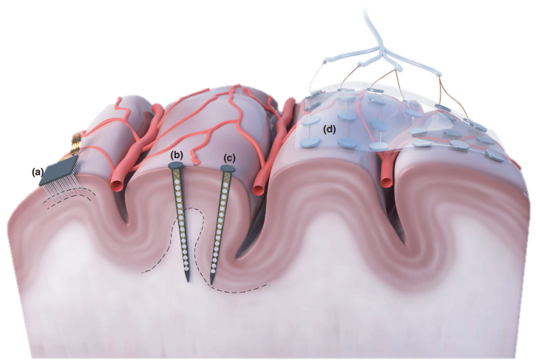
Material and Method(1/5)
- Main neural interface types -
cortical column
white matter
Fig. 4. Main neural types for interfacing with the cortex and associated electrode yield
7

Slide 14
Material and Method(2/5)
- Main neural interface types -
Penetrating MEAs (a) are generally positioned centrally within the gyrus to observe activity at a fixed depth (electrodes are on the tips of the shanks) corresponding to a certain layer in the cortical structure
scalability and portability：a rational design and customizable fit for organoids of different sizes[1]
electrode stability and yield：US FDA, 510(k) Summary, K110010,
NEUROPORT CORTICAL MICROELECTRODE ARRAY SYSTEM[2]
information transfer rate：Spectral content and bandwidth of vascular electrocorticography were comparable to those of recordings from epidural surface arrays[3]
[1] Huang, Q., Tang, B., Romero, J. C., Yang, Y., Elsayed, S. K., Pahapale, G., ... & Gracias, D. H. (2022). Shell microelectrode arrays (MEAs) for brain organoids. Science advances, 8(33), eabq5031.
[2] 510(k) Premarket Notification
[3] Oxley, T. J., Opie, N. L., John, S. E., Rind, G. S., Ronayne, S. M., Wheeler, T. L., ... & O'brien, T. J. (2016). Minimally invasive endovascular stent-electrode array for high-fidelity, chronic recordings of cortical neural activity. Nature biotechnology, 34(3), 320-327.
8

Slide 15
Material and Method(3/5)
scalability and portability：distributed freely-floating implants
information transfer rate：
a penetrating microelectrode can record from a small population of nearby neurons or even a single neuron, enabling precision recording of neural activity[4]
- Main neural interface types -
penetrating neural probes that are positioned centrally within the gyrus (b) observe activity parallel to the cortical surface, that is, along the cortical column, with possibility of deepest electrode sites situated in the white matter (thus reducing yield)
penetrating neural probes that are positioned proximal to the sulcus (c) observe activity parallel to the cortical surface so can generally observe similar activity to a penetrating MEA
[4] Weltman, A., Yoo, J., & Meng, E. (2016). Flexible, penetrating brain probes enabled by advances in polymer microfabrication. Micromachines, 7(10), 180.
9

Slide 16
Material and Method(4/5)
- Main neural interface types -
surface electrodes (d) require good contact (depending on whether they are placed epidurally or subdurally)
scalability and portability：Though such modalities have been used successfully for brain-machine interfaces, the non-portability of these systems makes them impractical for clinical BMI use[5]
electrode stability and yield： A Fully Implantable Wireless ECoG 128-Channel Recording Device for Human Brain–Machine Interfaces: W-HERBS[6]
information transfer rate： It is capable of recording 128-ch subdural ECoG signals with sufficient input-referred noise (3 μV_{rms}) and with an acceptable time delay (250 ms)[5]
[5] Degenhart, A. D. (2014). Evaluation and advancement of electrocorticographic brain-machine interfaces for individuals with upper-limb paralysis (Doctoral dissertation, University of Pittsburgh).
[6] A Fully Implantable Wireless ECoG 128-Channel Recording Device for Human Brain–Machine Interfaces: W-HERBS
10

Slide 17
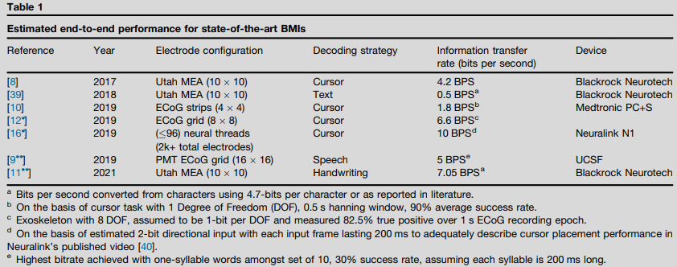
Material and Method(5/5)
- Performance-
Table. 1. Estimated end-to-end performance for state-of-the-art BMIs
11

Slide 18
Part 4
Result

Slide 19
Result(1/5)
-Trends-
The hope is that more channels of data will result in an increased information transfer rate in addition to improving robustness through increased redundancy
This up-scaling is seeing an emerging trend that is taking a distributed approach (comprising multiple devices, untethered and wireless) to the system organization, in addition to the current centralized approach (a single device wired to many electrodes)
These trends are leading to increased complexity in the deployment of the neural interfaces (e.g. more electrodes, flexible, freely-floating)
The trends we are seeing are all ultimately aimed at improving the overall efficacy of the BMI (information transfer rate, accuracy)
12

Slide 20
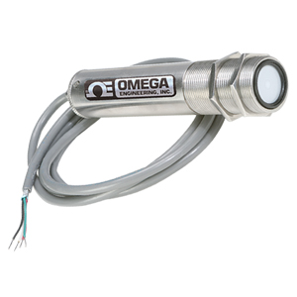
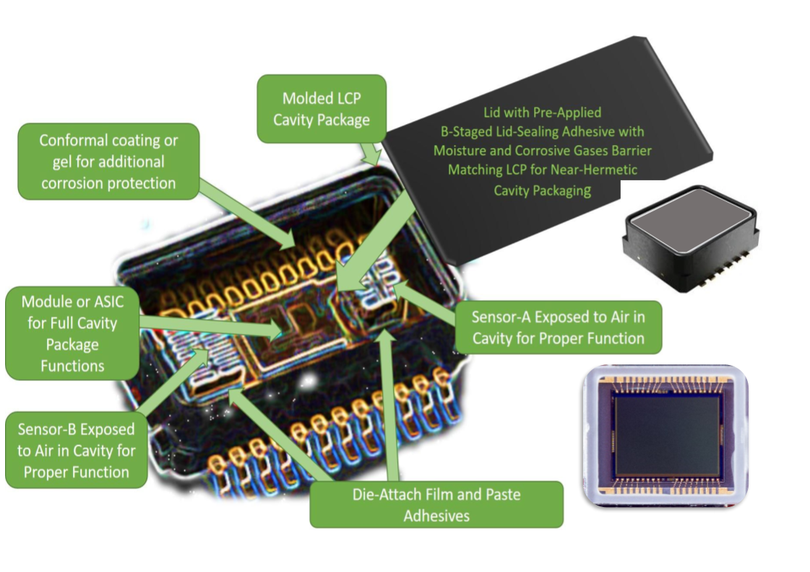
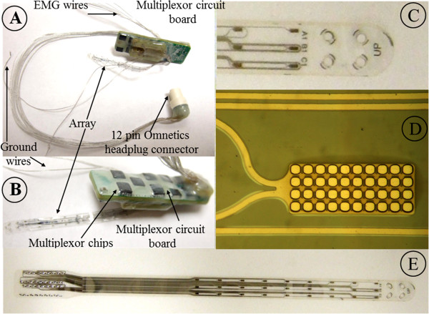
Result(2/5)
-Centralized vs Distributed-
Centralized
This approach builds on the current modular organization of active implantable medical devices that comprise a single hermetically packaged electronic module, multiconductor feedthroughs and implanted leads connecting to the electrode array(s)
Fig. 5.
a single hermetically packaged electronic module
Fig. 6.
multiconductor feedthroughs
Fig. 7.
implanted leads connecting to the electrode array(s)
13

Slide 21
Result(3/5)
-Centralized vs Distributed-
Centralized
Weakness : Power remains fundamentally constrained by available space for batteries and maximum thermal output of the implant
Strength : well-established inductive links such as those found in cochlear implants remain the primary powering method for centralized implant architectures, owing to the space available for larger and more efficient coils
14

Slide 22
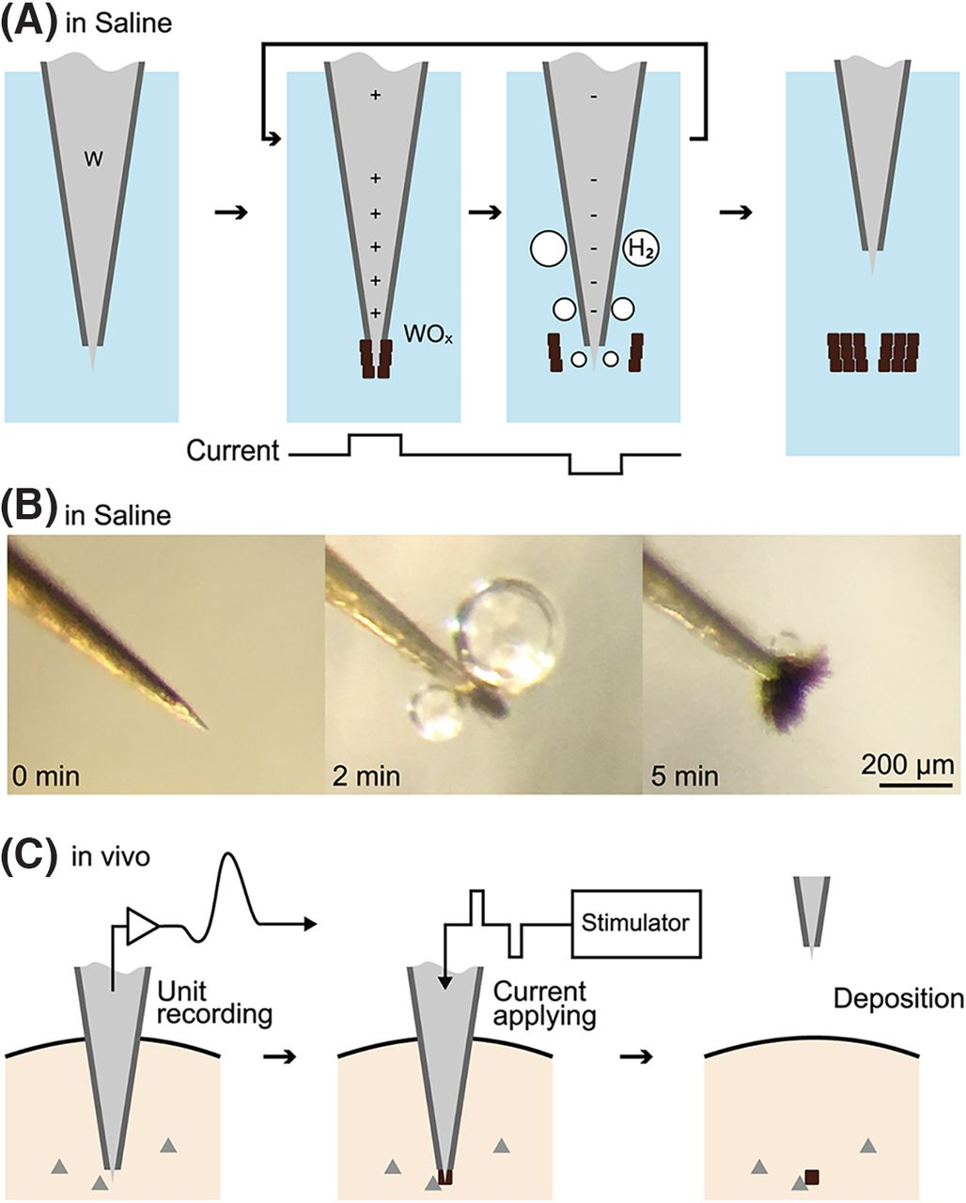
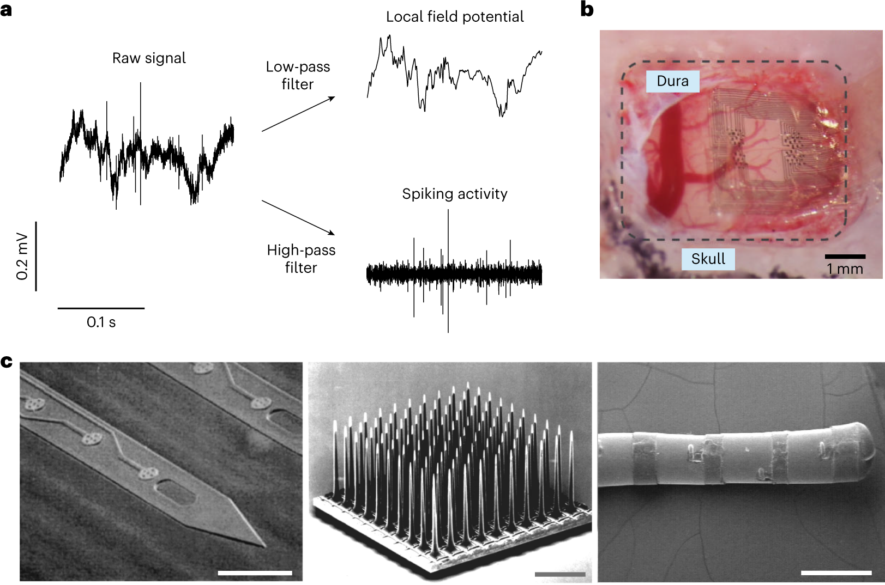
Result(4/5)
-Centralized vs Distributed-
Distributed
An emerging trend that has gained pace in the last 3 years is that of distributed BMIs. This is achieved by ‘splitting’ the system into several tiny devices that are each freely floating and completely wireless. neurogranin's (using patterned gold/PEDOT:PSS electrodes), FF-WINeR (using tungsten microelectrodes), and ENGINI (using microwire electrodes)
Fig. 8.
neurograins (using patterned gold/PEDOT:PSS electrodes)
Fig. 9.
FF-WINeR (using tungsten microelectrodes)
15

Slide 23
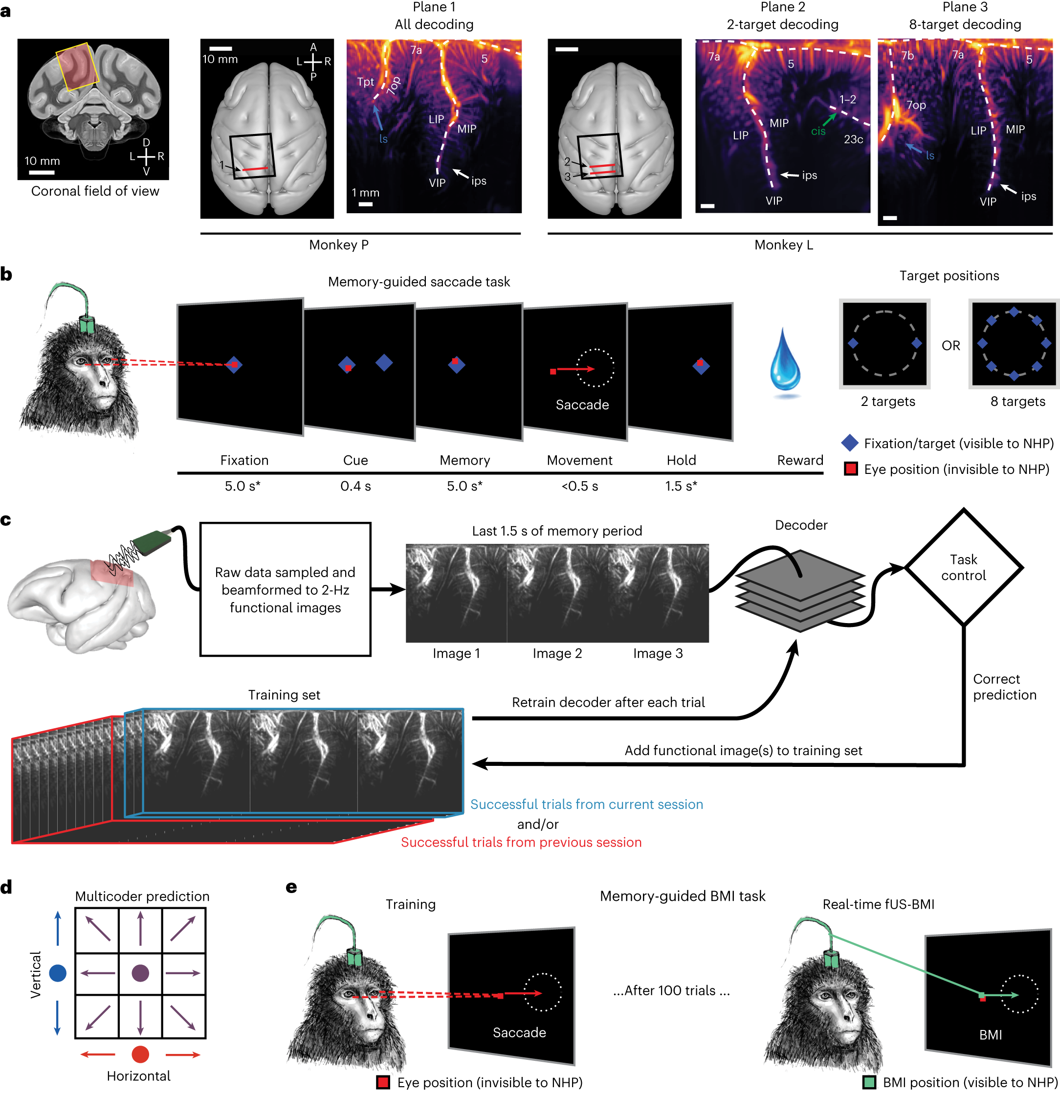
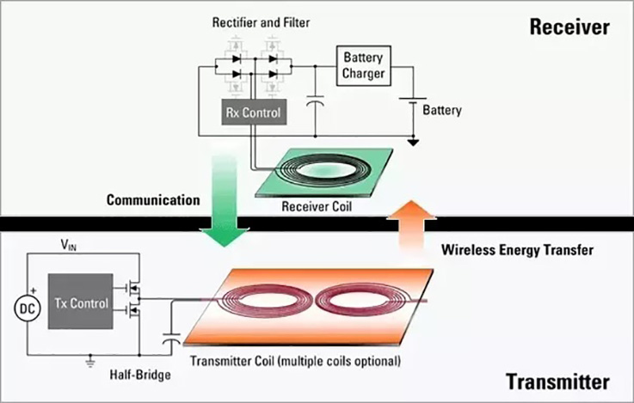
Result(5/5)
-Centralized vs Distributed-
Distributed
Fig. 10.
ultrasonic transmission
Fig. 11.
multi-coil inductive coupling
Threats : how to achieve efficient wireless power transmission to such small devices, how to communicate data robustly, how the devices are implanted, etc.
Opportunities : The two main approaches that have been adopted in recent work to address the wireless power challenge are ultrasonic transmission, and multi-coil inductive coupling
16

Slide 24
Part 5
Discussion

Slide 25
Discussion(1/2)
With the increased complexity and miniaturization of implantable devices, there are new challenges for packaging. Current work is thus exploring new methods for realizing packaging solutions that are biocompatible and remain reliable for decades
The aim of emerging BMI technologies is to improve the overall performance whilst maintaining safety
Performance encompasses :
chronic reliability
output bandwidth (useful information transfer rate)
output accuracy/confidence level
Combining BMI with neuromorphic computing architectures to implement machine learning models for neural information decoding while saving on power and area is also an emerging trend
17

Slide 26
Discussion(2/2)
With increased complexity in BMI devices come challenges with the implantation itself.
How can a soft, flexible probe or delicate microwire probe be implanted without buckling?
How can hundreds of tiny implants be positioned?
This has motivated parallel efforts on surgical workflow; for each new device, we are also seeing a companion surgical method being developed
machine-inspired robot inserting neural threads
laser ablation surgery or an anti-buckling mechanism for microwire insertion
neurovascular surgery for stent rode device insertion
a shuttle-based delivery mechanism
injectable devices
18

Slide 27
Part 6
Conclusion

Slide 28
Conclusion
The most recent advances in implantable BMIs have been in two key directions :
optimizing performance for existing neural interfacing technologies
developing new neural interface technologies to allow for scalability and/or new surgical workflows
For medical applications in general, clinical necessity is the primary driver, with validation studies establishing technology maturity and scientific viability
It is crucial to assess the development cost, healthcare economics, and viability for workflow integration
Additionally, BMIs and potential applications pose several ethical concerns including agency/autonomy of the user, enhancement limitations, perception of normality, privacy, equality
19

Slide 29
The End

